Slide 1
Design Principles
Instructor: Mehroze Khan

Slide 2
Design Principles
Design principles are guidelines for decomposing a system’s required functionality and behavior into modules
The principles identify the criteria
for decomposing a system
deciding what information to provide (and what to conceal) in the resulting modules
Six dominant principles (general):
Modularity
Interfaces
Information hiding
Incremental development
Abstraction
Generality

Slide 3
Modularity
Modularity is the principle of keeping the unrelated aspects of a system separate from each other,
each aspect can be studied in isolation (also called separation of concerns)
If the principle is applied well, each resulting module will have a single purpose and will be relatively independent of the others
each module will be easy to understand and develop
easier to locate faults
because there are fewer suspect modules per fault
Easier to change the system
because a change to one module affects relatively few other modules
To determine how well a design separates concerns, we use two concepts that measure module independence: coupling and cohesion
Notes:
Concerns can be functions, data, features, tasks, qualities, or any aspect of the requirements or design that we want to define or understand in more detail.

Slide 4
Modularity: Coupling
Two modules are tightly coupled when they depend a great deal on each other
Loosely coupled modules have some dependence, but their interconnections are weak
Uncoupled modules have no interconnections at all; they are completely unrelated

Slide 5
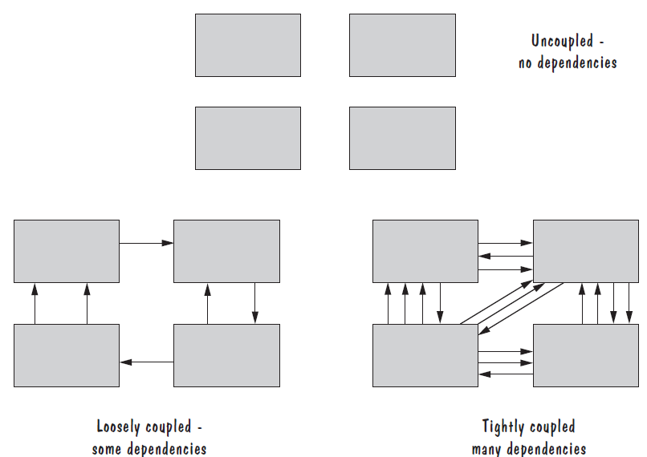
Modularity: Coupling

Slide 6
Modularity: Coupling
There are many ways that modules can depend on each other:
The references made from one module to another
The amount of data passed from one module to another
The amount of control that one module has over the other
Coupling can be measured along a spectrum of dependence, ranging from complete dependance to complete independence
Notes:
The references made from one module to another: Module A may invoke operations in module B, so module A depends on module B for completion of its function or process.
The amount of data passed from one module to another: Module A may pass a parameter, the contents of an array, or a block of data to module B.
The amount of control that one module has over the other: Module A may pass a control flag to module B. The value of the flag tells module B the state of some resource or subsystem, which procedure to invoke, or whether to invoke a procedure at all.

Slide 7
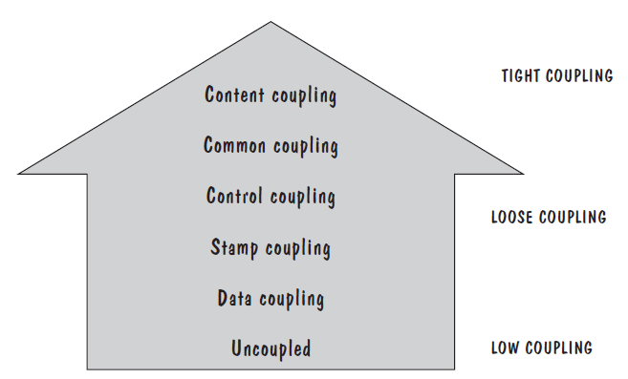
Modularity: Types of Coupling
Content coupling
Common coupling
Control coupling
Stamp coupling
Data coupling
High coupling is not desired

Slide 8
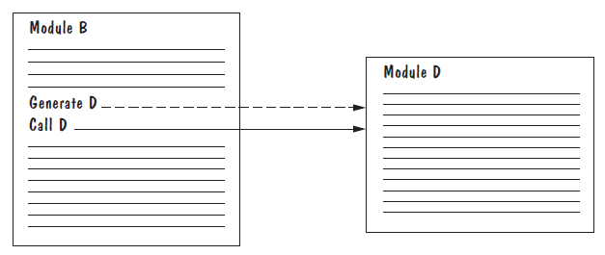
Modularity: Content Coupling
One module modifies another. The modified module is completely dependent on the modifying one
Content coupling might occur when one module is imported into another module, modifies the code of another module, or branches into the middle of another module

Slide 9
Modularity: Common Coupling
We can reduce the amount of coupling somewhat by organizing our design so that data are accessible from a common data store.
Dependence still exists; making a change to the common data means that, to evaluate the effect of the change, we must look at all modules that access those data.
With common coupling, it can be difficult to determine which module is responsible for having set a variable to a particular value.

Slide 10
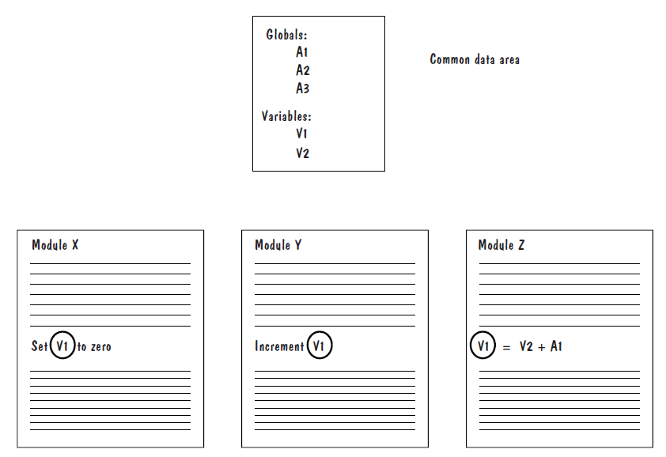
Modularity: Common Coupling

Slide 11
Modularity: Control Coupling
When one module passes parameters or a return code to control the behavior of another module
It is impossible for the controlled module to function without some direction from the controlling module
Limit each module to be responsible for only one function or one activity.
Restriction minimizes the amount of information that is passed to a controlled module, and it simplifies the module’s interface to a fixed and recognizable set of parameters and return values.

Slide 12
Modularity: Stamp and Data Coupling
When complex data structures are passed between modules, we say there is stamp coupling between the modules
Stamp coupling represents a more complex interface between modules, because the modules have to agree on the data’s format and organization
If only data values, and not structured data, are passed, then the modules are connected by data coupling
Data coupling is simpler and less likely to be affected by changes in data representation.
Easiest to trace data through and to make changes to data coupled modules.

